Slide 1

Positive Behavioral Interventions and Supports (PBIS)
Sound Supports
www.soundsupportsk12.com

Slide 2
Quick Assessment
Activity
In Regards to PBIS:
What Do You Know?
Want Do You Want To Know?
What Are You Excited About?
What Are Your Fears/Reservations?

Slide 3

What is School-wide PBS?
School-wide PBS is:
  A systems approach, establishing the social culture and behavioral supports needed for schools to be effective learning environments for all students.
Evidence-based features of SW-PBS
  Prevention
  Define and teach positive social expectations
  Acknowledge positive behavior
  Arrange consistent consequences for problem behavior
  Collection and use of data for decision-making
  Continuum of intensive, individual interventions.
  Administrative leadership – Team-based implementation

Slide 4
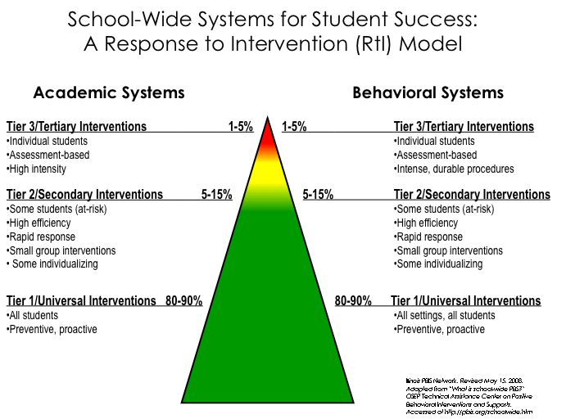
Notes:
4

Slide 5
Universal
Targeted
Intensive
Math
Science
Continuum of Support for ALL
Spanish
Reading
Soc skills
Soc Studies
Basketball
RACHEL
Notes:
NOTICE GREEN GOES IS FOR “ALL”

Slide 6
Why Implement PBIS?
Create a positive school culture:
School environment is predictable
1. common language
2. common vision (understanding of expectations)
3. common experience (everyone knows)
School environment is positive
regular recognition for positive behavior
School environment is safe
violent and disruptive behavior is prevented
School environment is consistent
adults use similar expectations.
Notes:
Who is the kid that needs the most consistency and build your system around it—McClure Middle School example

Slide 7
School-wide Systems
1. Common purpose & approach to discipline
2. Clear set of positive expectations & behaviors
3. Procedures for teaching expected behavior
4. Continuum of procedures for encouraging expected behavior
5. Continuum of procedures for discouraging inappropriate behavior
6. Procedures for on-going monitoring & evaluation
Notes:
7
Stress: Although most schools have a written code of conduct or discipline policy-- which is important-- it tends to focus on procedures for processing rule violations (#5 on the slide).
Effective school-wide discipline systems have a matching and strong proactive component that teaches and encourages pro-social behavior, and provides an on-going progress monitoring system.
The remaining five items are important but difficult to sustain without clear school-wide investments and structures in place.

Slide 8
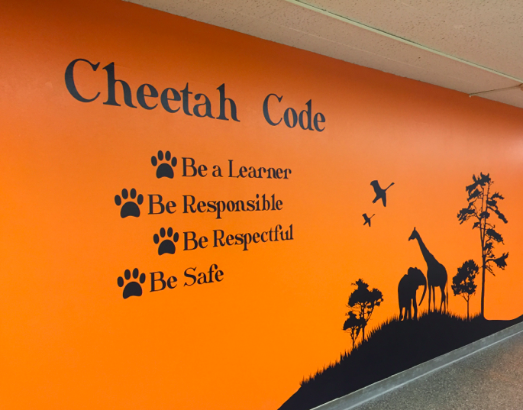
Establishing and Teaching Expectations

Slide 9

Forest View School-wide expectations
Be Respectful
Be Responsible
Be Safe

Slide 10
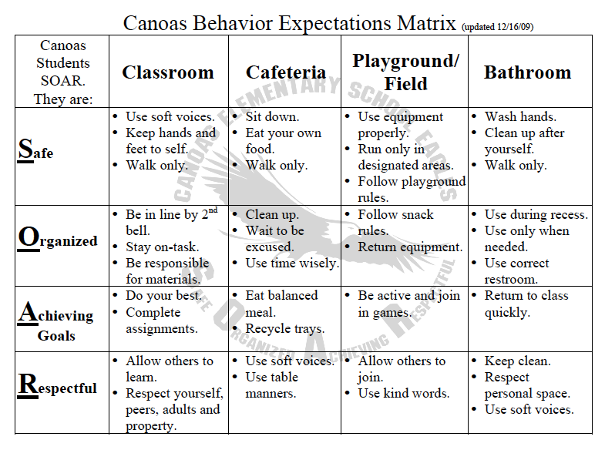

Slide 11

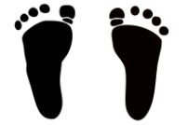
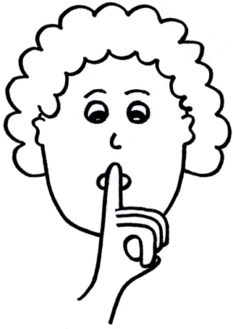
Sample Matrix - Arrival
Expectation | Be Responsible | Be Respectful | Be Safe
Behavior | Be on time | Obey Supervisors | Watch for cars
Behavior | Put your coat away | Keep hands and feet to self | Use cross walks and sidewalks
Behavior | Have your supplies | Enter class quietly | Walk at all times
Notes:
Add pictures, more review, clarification

Slide 12
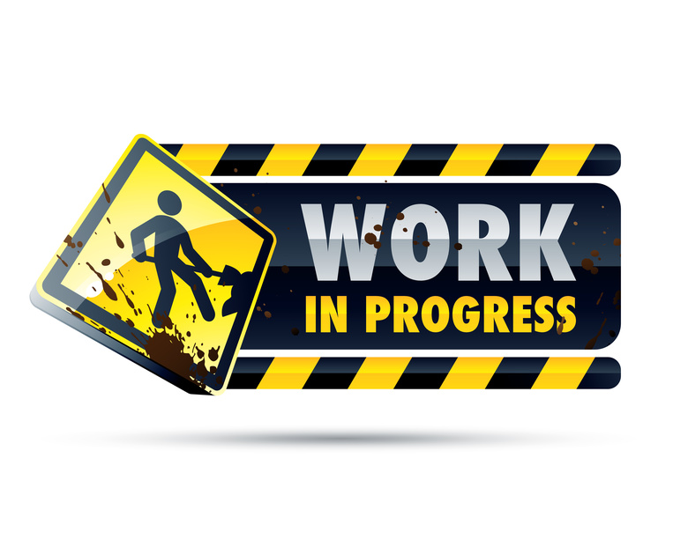
Forest View Matrix
Buses
Cafeteria
Classroom
Hallway
Notes:
What’s next? Work with a partner to identify other key locations

Slide 13
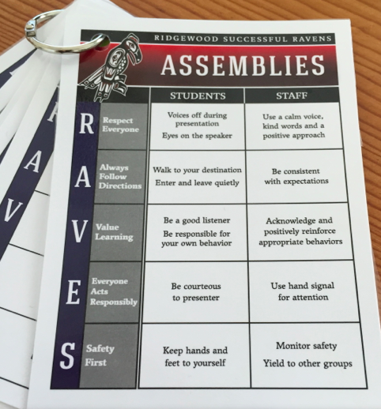

Slide 14
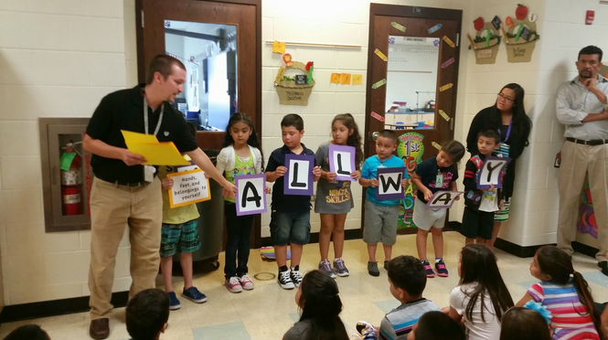
Teaching Expectations
Notes:
Ask – table groups how are you doing this work already. What next?

Slide 15
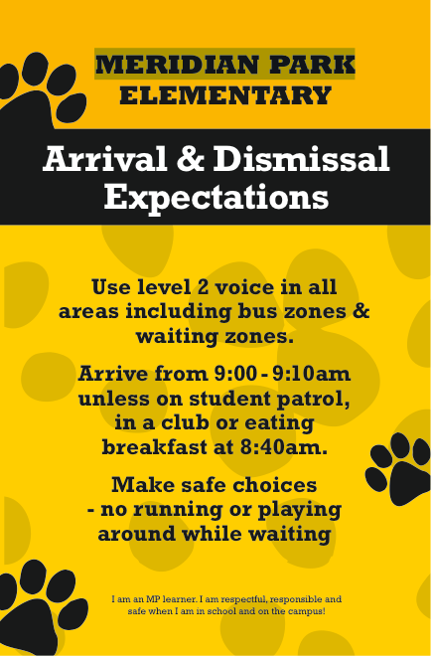

Slide 16
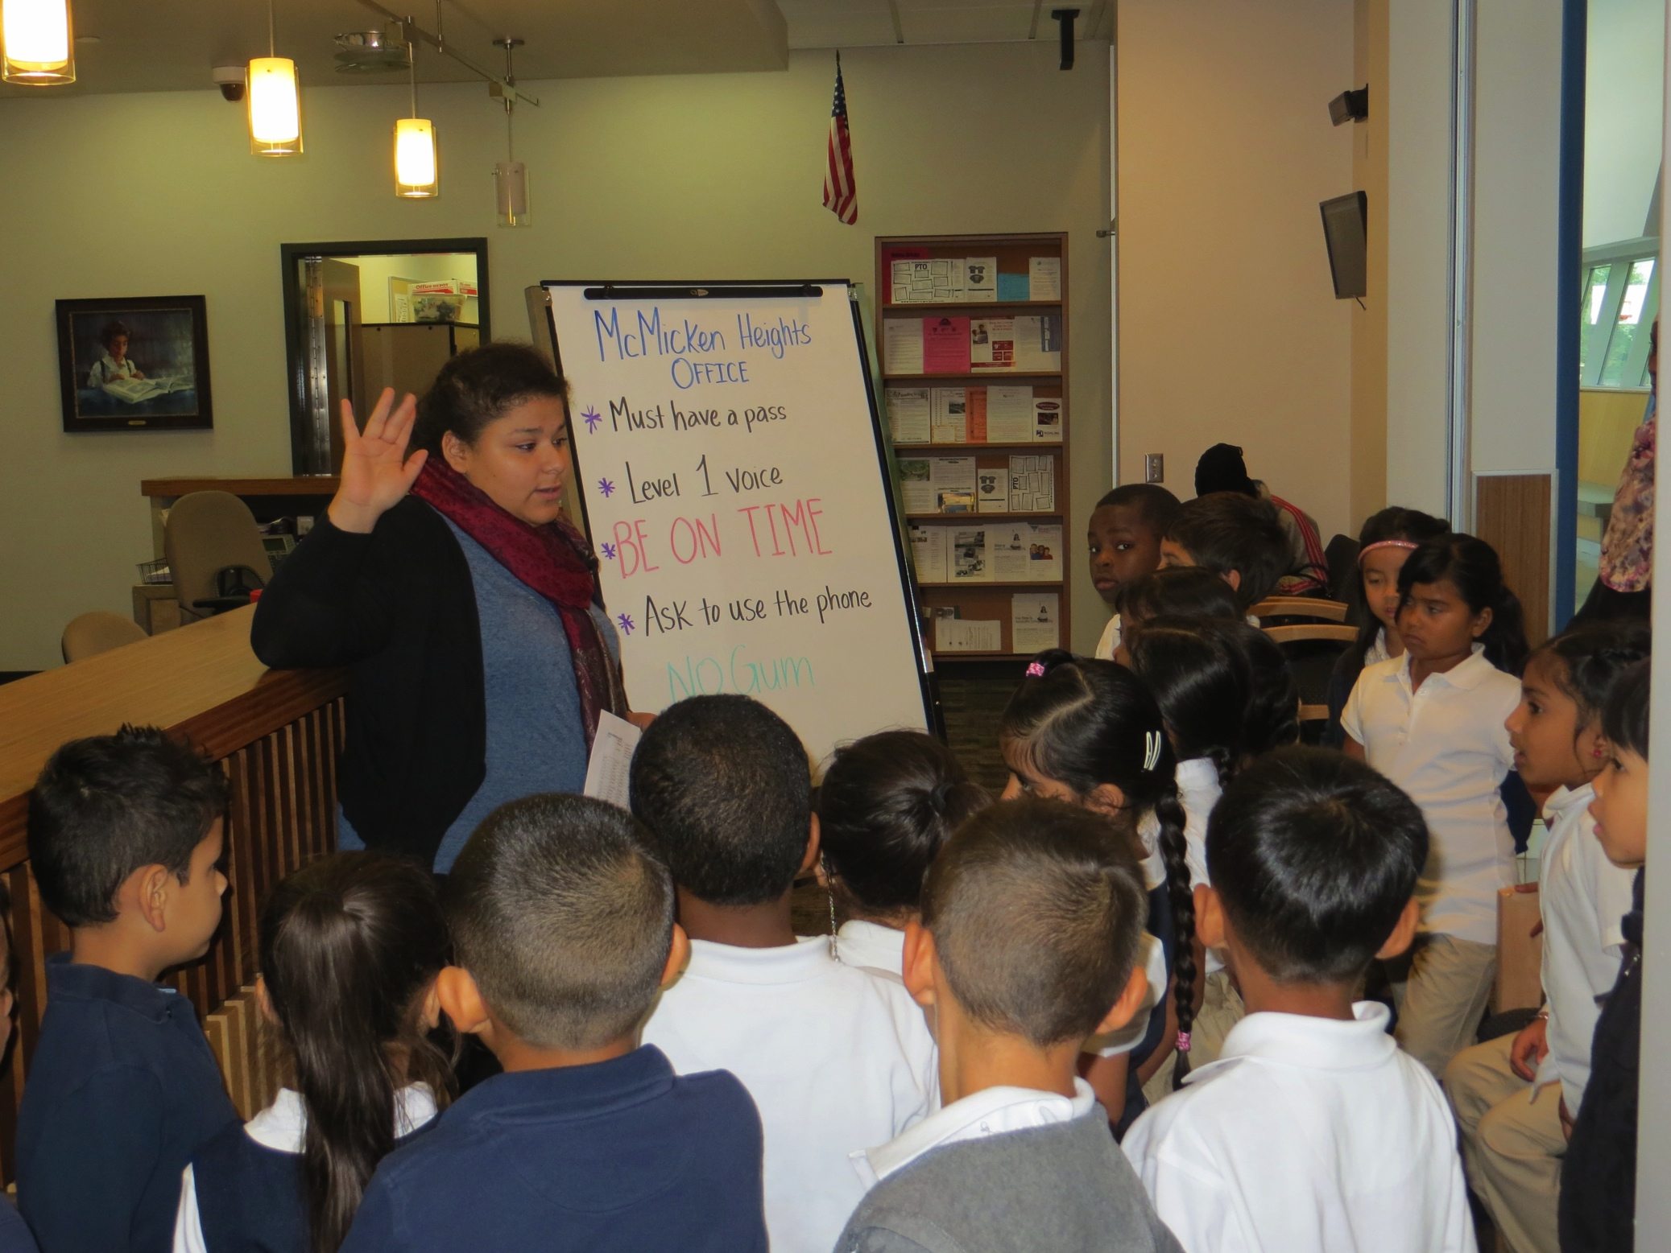

Slide 17
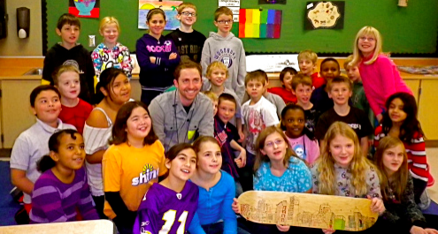
Acknowledgement Systems in PBIS……Its About Feedback and Relationships

Slide 18
Relationships matter
Students, especially low-income students, have higher academic outcomes and more positive social-emotional adjustment than their peers who do not have a positive relationship with their teacher (Murray and Malmgren, 2005).
For high school students, positive relationships can decrease the risk of drop-out by nearly 50% (Dika and Singh, 2002).
Teacher-student relationships and interactions can impact peer perceptions and acceptance of students (Hughes et al., 1999).

Slide 19
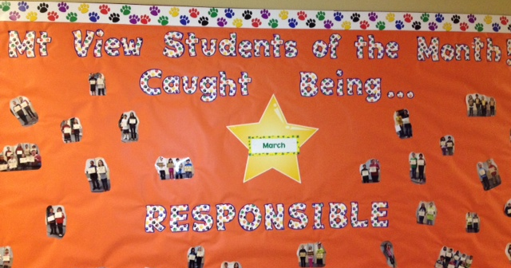
Students Caught Being Responsible
Notes:
Falcon Tickets in the cafeteria

Slide 20
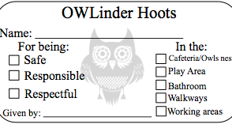
Using A Ticket System

Slide 21
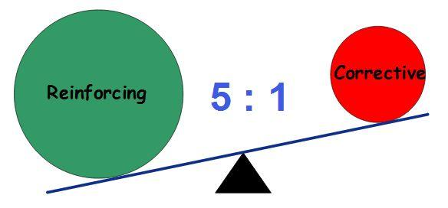
5:1 ratio = High Performance
The positivity/negativity ratio (P/N) has been found to be a critical indicator of Performance
High Performance teams = 5.6 : 1
Medium Performance teams = 1.9 : 1
Low Performance teams = .36 : 1
Losada & Heaphy 2004
Notes:
*
Looked at work teams when they had built in feedback systems for each other

Slide 22
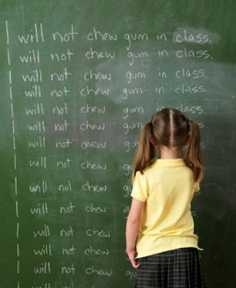
Clear and Consistent Procedures for Dealing With Problem Behaviors
Notes:
Systems to responding to problem behaviors

Slide 23
Punishment vs Discipline
Punishment or consequence works as an immediate way to try and get a behavior to stop and to “make the child pay” for what has occurred.
Discipline defined means teaching, learning and giving instruction. Discipline offers skills that can change behavior. It can help the developing brain make connections about good choices.
We want to respond, not react.

Slide 24
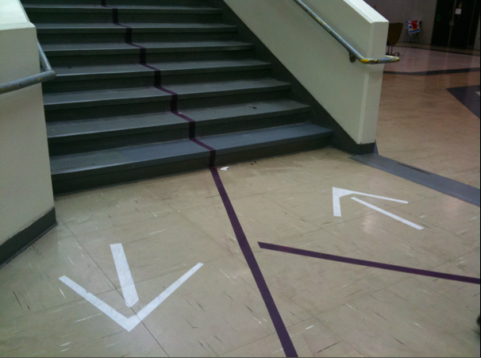
Prevention
How can we decrease the likelihood the behavior will occur?

Slide 25
Level out behaviors
Staff Managed - Minor | Office Managed - Major
Arguing Cell Phones Cheating/Lying Computer Use – Inappropriate Electronic Toys Inappropriate Dress Inappropriate Language Making Noises Minor Vandalism Name Calling Non-participation Not Listening Not Sitting in Seat Off Task Poking Splitting Talking Out Tardy | Accessing Off Limits Areas Aggressive Language/Threats Blatant Insubordination Danger to Self and Others Discrimination Explicit Language Extortion/Robbery Fighting Harassment/Intimidation/Bullying Illegal Substances Leaving School Grounds Lewd Behavior Major Vandalism Significant Disruptive Behavior Repetitive Minor Infractions Truancy Uncontrollable Screaming/Yelling Weapons

Slide 26
Define Behaviors - Example
Minor Level Behaviors | Definition
Inappropriate Language | Student curses or uses foul language but it is not extreme or directed towards anyone. Examples Include: This Sucks, Oh Shit, Hell No
Cell Phones | Student has phone out and is using it at off-limits time and without permission.
Minor Vandalism | Minor level damage that can easily be cleaned or fixed. Examples Include: Drawing on desk, Marking/Writing on another students’ work
Tardy | Student arrives after the last bell has rung, but within the first 5 minutes.

Slide 27
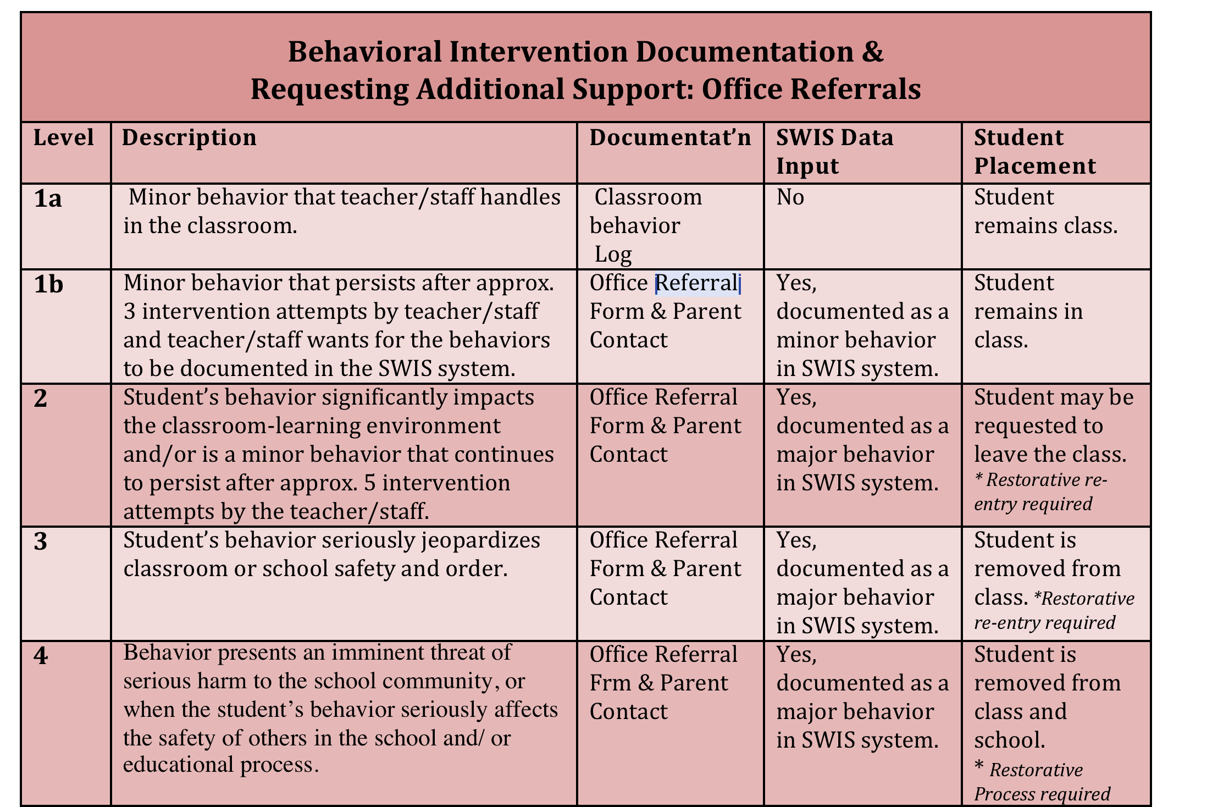

Slide 28
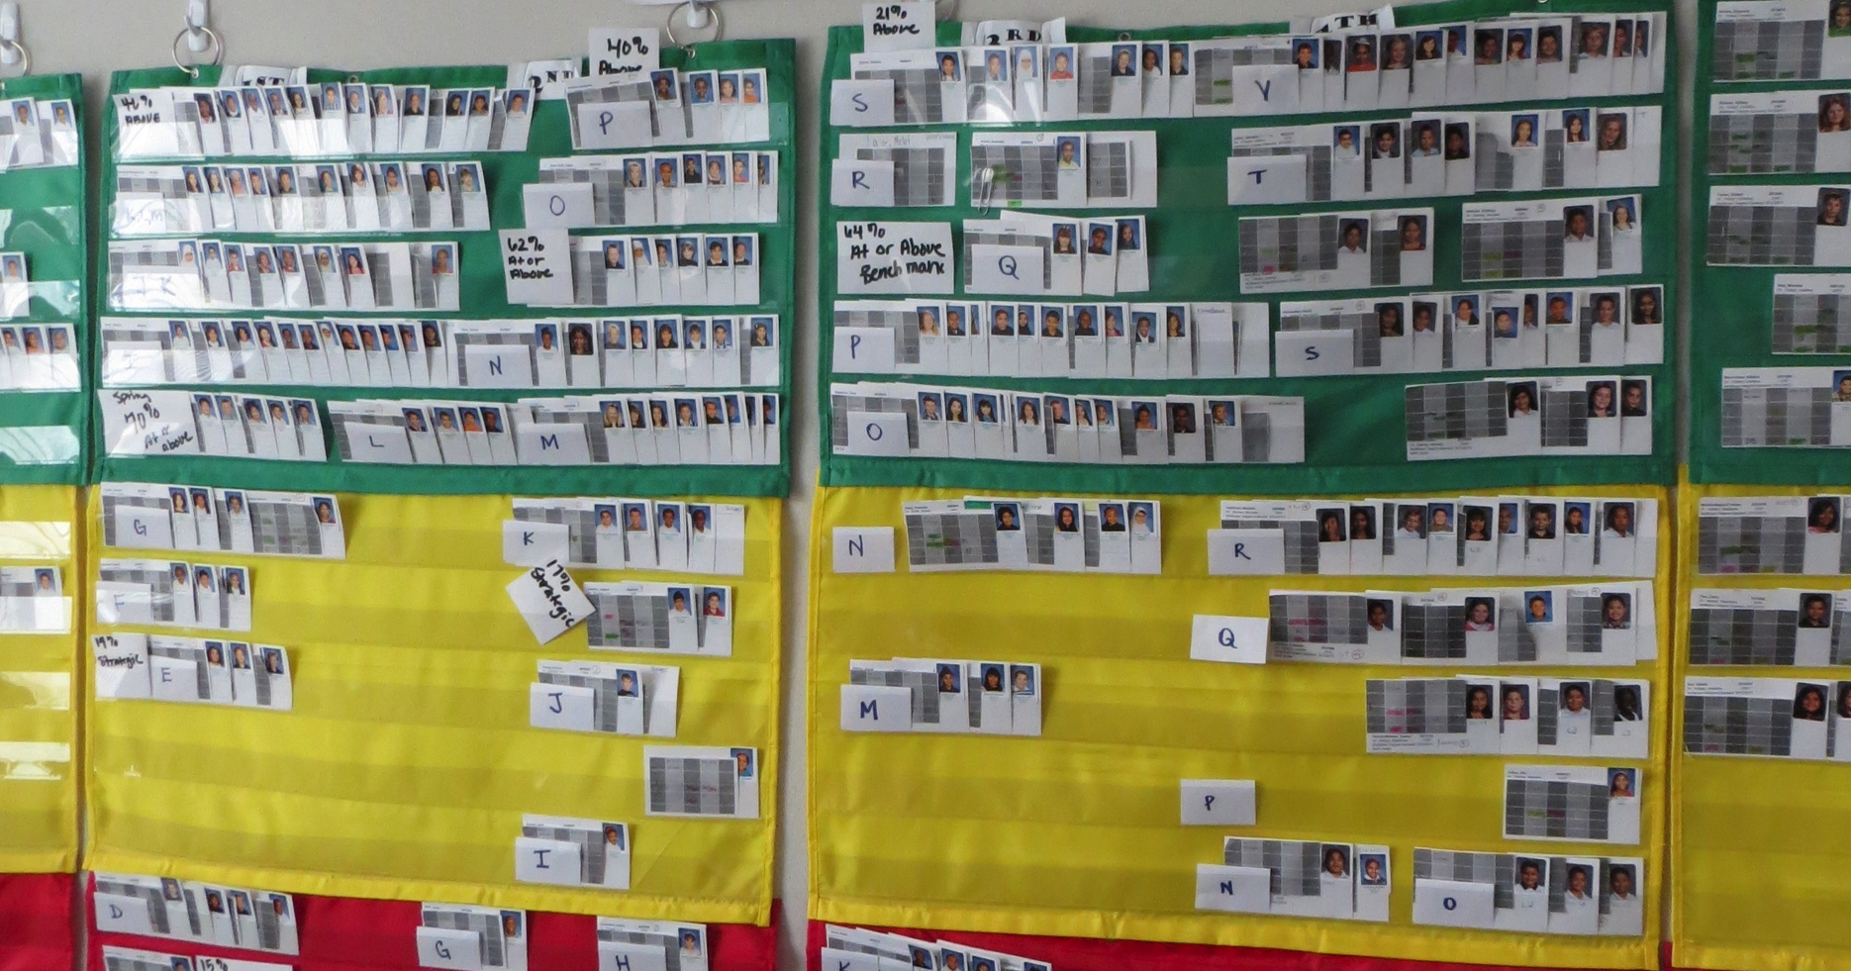
Data, Monitoring and Early Intervention

Slide 29
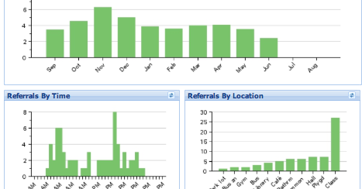
Data-Based Decision Making

Slide 30
Results from SWPBS
Reduction in Office Referrals
Reduction in Suspension
Reduction in Drop Outs
Increase in Academic Gains
Increase in Staff Satisfaction
Increase in Student Satisfaction
* Return on Investment is High

Slide 31
Big Messages
This is SYSTEMS Change
Adult behavior change is step #1
It can take 5 or more years to put all three tiers in place.

Slide 32

Establishing the PBIS Leadership Team
Notes:
32

Slide 33
Final Q & A
After hearing this information, what questions about PBIS do you still have?

